Slide 1
AC297r Fall 2019
Final Presentation
Optimal Real-time Scheduling for Black Hole Imaging
EHT Group: Queena, Shu, Yiming
Advisor: Cecilia
Notes:
Hi everyone, we are the black hole team. I’m Shu, this is Queena, and yiming is too sick to present today, but she recorded a video that will be played at the end to showcase our software. we partner with the event horizon telescope to solve the problem of ….

Slide 2
Outline
Background
Problem Statement
Data
Model Design
Model Evaluation
Software Demonstration
Reflection
Notes:
Here is our agenda for the talk. We will guide you through the background of this project, the actual problem, the data we gathered, the model designs and their performance. We will show a video on how to use our software and talk a bit about our overall process.

Slide 3

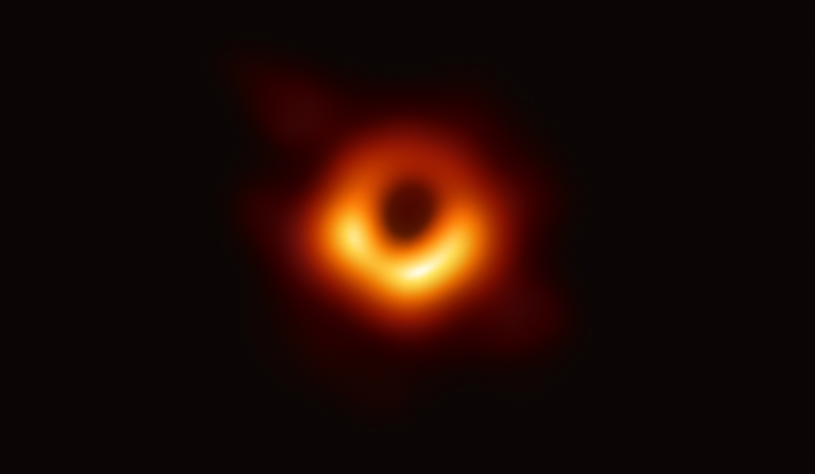
Background
The Event Horizon Telescope is an international collaboration capturing images of black holes using a virtual Earth-sized telescope.
Notes:
Our partner that I just mentioned is the Event Horizon Telescope Collaboration. On April 10, 2019, they released the first image of a black hole in human history. They won the 2020 Breakthrough Prize in Fundamental Physics. Shepard Doeleman is the founding director of EHT. After the photo of the black hole was taken, he approached to Pavlos asking for some help.

Slide 4
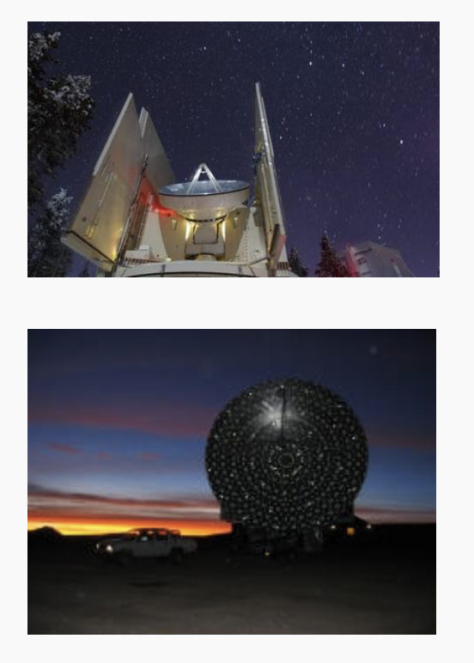
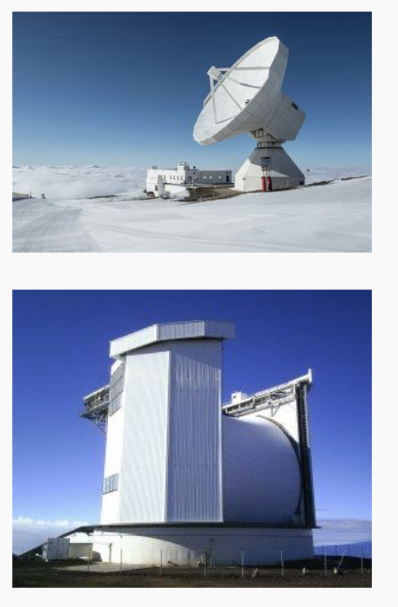
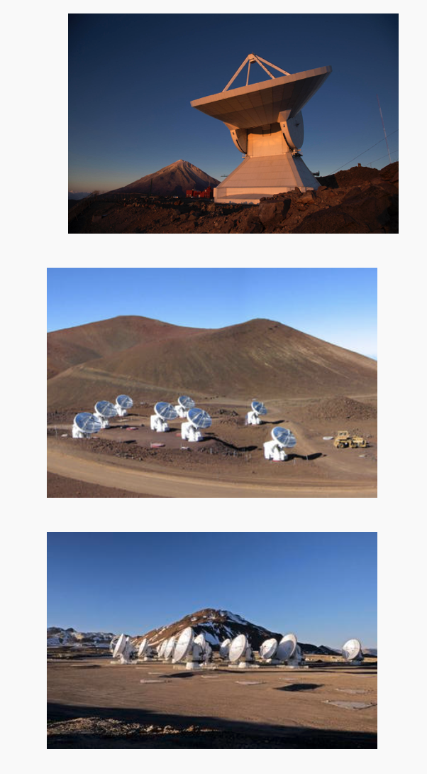
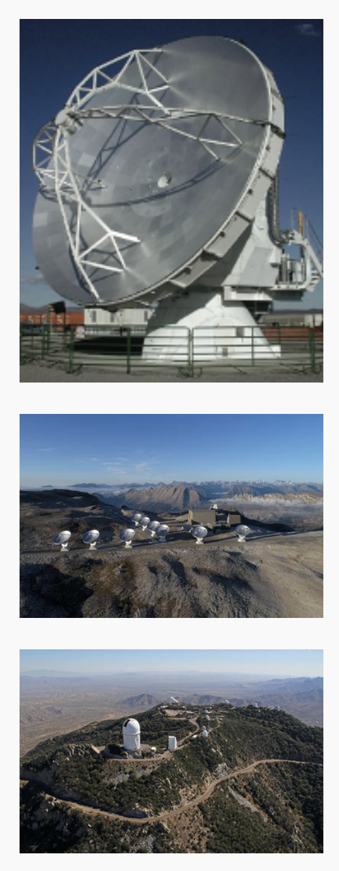
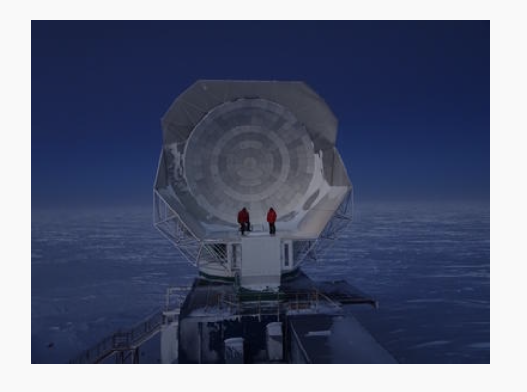
Background
Notes:
Shep told us, to obtain high resolution images of a black hole, they use the technique of very long baseline interferometry, in which radio dishes across the globe are synchronized to form a virtual telescope the size of the earth. with the highest angular resolution currently possible from the surface of the Earth.
How high is the resolution? It is equivalent to being able to read a newspaper in Los Angeles while sitting in Boston.
To operate in this way, the EHT requires reasonably good weather across most of the array at the same time. Currently there are eleven radio dishes in the array. Observing conditions can be excellent in some locations, but if there aren’t enough telescopes that can participate due to poor weather elsewhere, observations cannot proceed as they wouldn’t produce high quality data.
Also, it’s very expensive to operate these giant telescopes and scientists compete to use them, so the EHT is only provided with a 10-day window in each year. Every year, the 10-day window would be different.
Not only that, out of this 10-day window, they can only trigger 5-6 days due to some other constraints.
Currently, Shep manually decides whether to trigger the day. He makes the decision by calling his friends working at each site and ask, what do you think about the weather?He wanted us to build some real-time algorithms, that can facilitate his decision-making process.

Slide 5
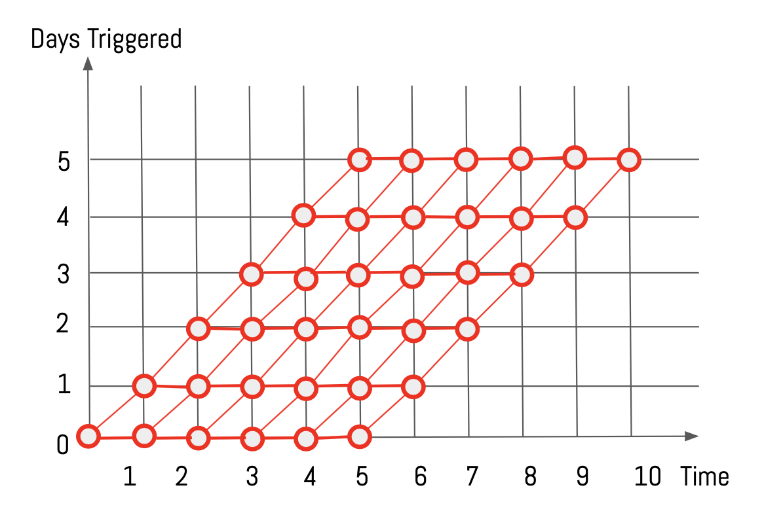
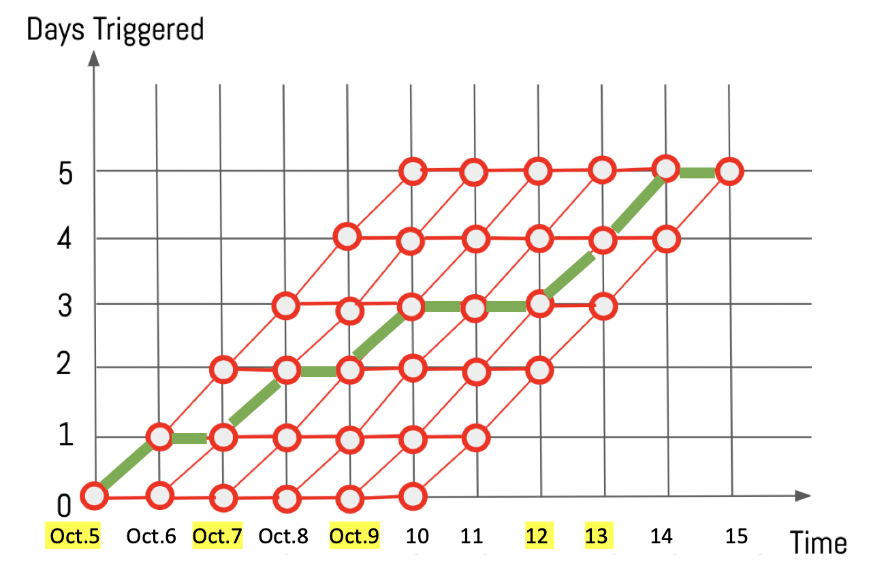
Problem Statement
We are going to build a model that can:
In total, choose 5 days from a 10-day window
On each day, determine the optimal strategy for future remaining days
If possible, provide a confidence level on its suggestion
Also provide the second optimal strategy
Notes:
Our goal is to maximize the number of high-quality photos of the Black Hole.
Given the weather forecast and the dates information, In total, we can only select five days out of consecutive 10 days. the algorithm should make suggestions on-the-go, namely whether to trigger on that day, and the optimal strategy for the future remaining days.
If possible, the EHT also wants our model to output the confidence level and second optimal strategy.
Here is a demonstration of what this problem is. The x axis represents the dates in the 10-day window, while the y axis represents the number of days that have been triggered so far. On each day, if we determine to trigger on the next day, we move up in the diagonal, and if we suggest skipping the next day, we move horizontally. In the end, we must reach one of the points in the top line. The green line here shows a possible path.

Slide 6
Motivations
Improve the decision making process
Increase the chance of capturing the black hole
Notes:
Our motivations are two-fold. If our model is successful, they are for sure going to use it to facilitate their decision making process. And the next window is in March. Second, this is a huge motivation for us, as we know we also contribute to human’s discovery of the universe, by increasing the chance of capturing black hole pictures.

Slide 7
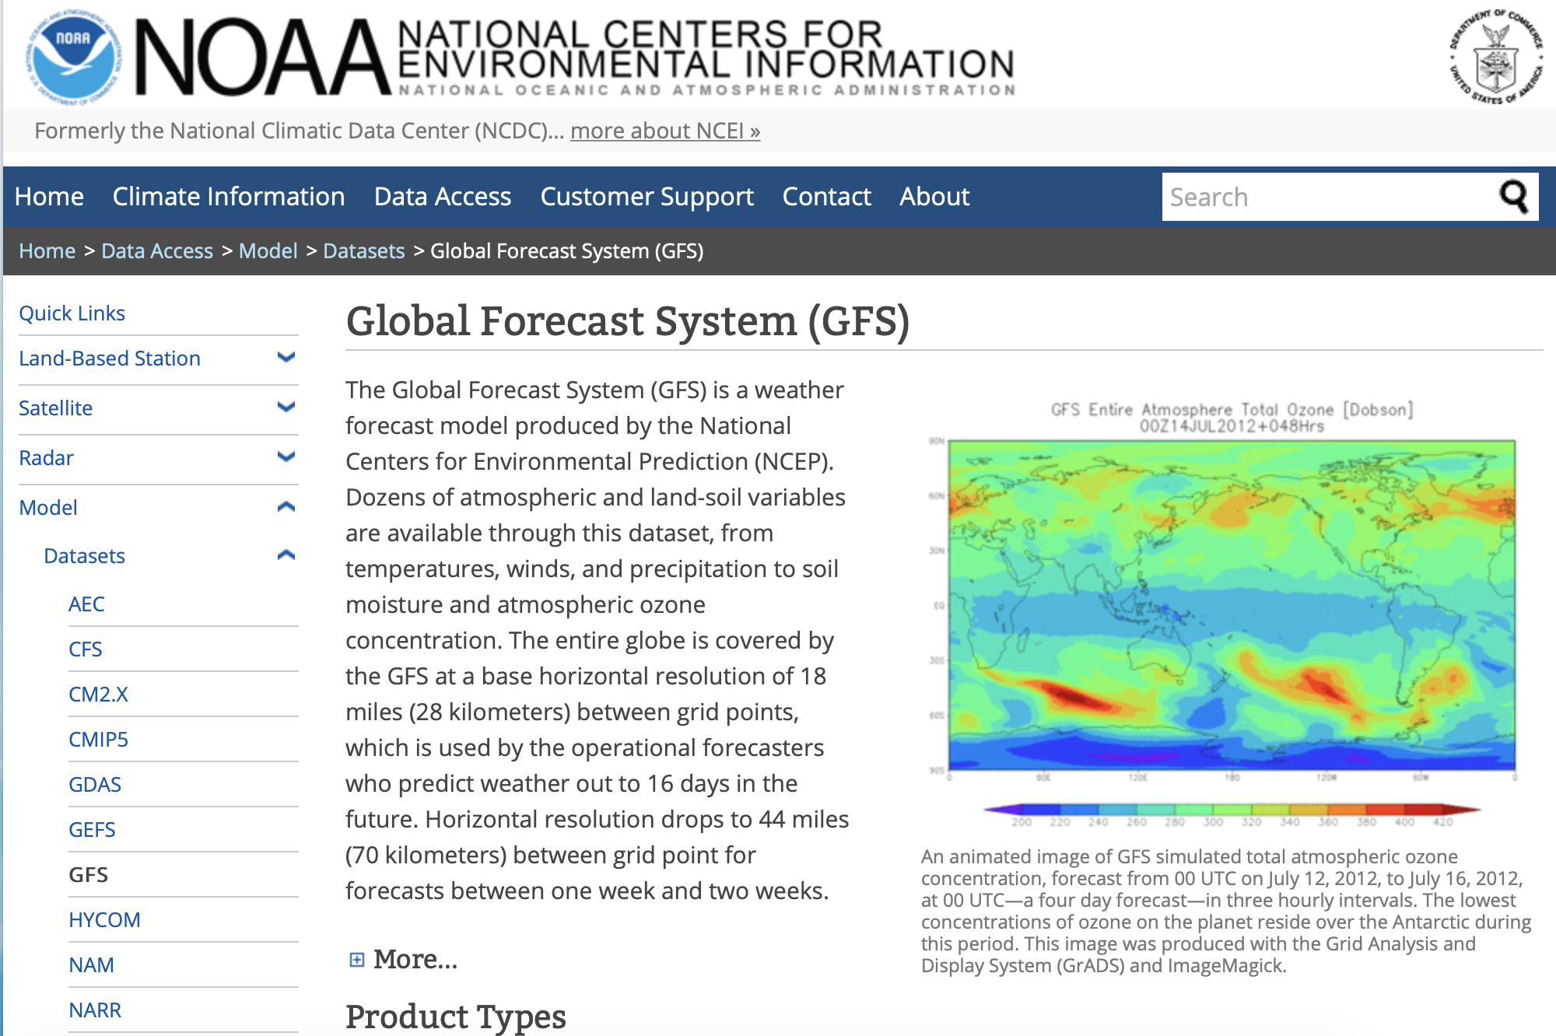
Data Source
GFS provides:
Atmosphere’s condition
Layer-by-layer
All over the globe
We pull data every 6 hours specifying:
Longitude
Latitude
Altitude
Notes:
We collected our data from the GFS, which is a weather forecast model produced by the national centers for environmental information. It is public. It provides layer-by-layer atmosphere forecast all over the globe. You can think of its data in a 3D shape. Every 6 hours, the GFS produces a set of predictions, and we pull the weather forecast for each telescope’s location. We do that by specifying the telescopes’ longitudes, latitudes, and altitudes.

Slide 8
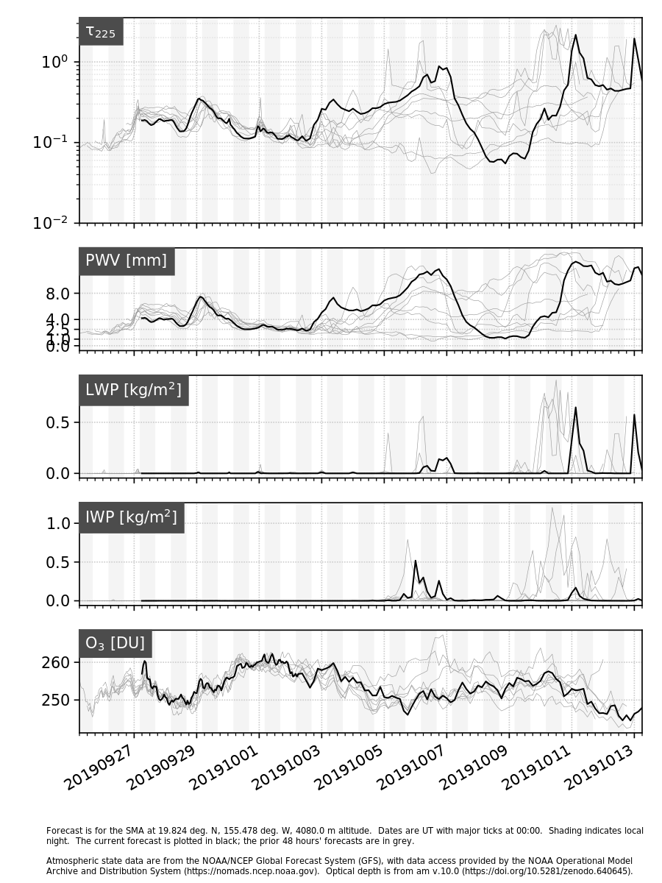
EDA
Every 6 hours, we get 16-day atmosphere forecast from GFS.
First 5-day forecast is pretty accurate.
Variables: Tau_225(absorption directly above head, the lower the better), PWV, LWP, IWP (amount of water in different forms), O3
Notes:
Here is what our data look like. There are five plots here, because the GFS makes predictions for five variables. On each graph, you see there is one black line and eight gray lines. This is because for each 6 hours, we get a new set of weather forecast data, so the black line represents the latest forecast data, while the grey lines are predictions made in the past 48 hours.
Each forecast covers 16 days in the future and it has predictions for every hour.
We were told by the experts that the first variable, Tau-22,5 is the most important one to indicate clarity of the atmosphere, as it is the absorption rate directly above head. A smaller Tao-225 is more preferred than a larger one.

Slide 9
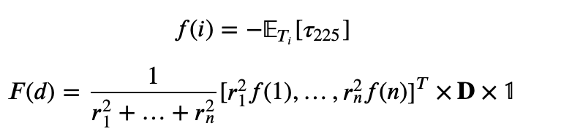
Model Design: Baseline
Reward functions:
Symbols
i: a telescope
T_{i}: observation window
r_{i}: radius of telescope i
D: baseline length matrix
Notes:
That’s all the data we got, and now we are going to build models.
We borrowed the idea of reward functions from reinforcement learning. Each telescope would get a reward value based on its weather condition. The reward function for each telescope is being called the small f.
Each day is assigned a reward value, for which the reward function is called the big F.
In the baseline model, we construct the reward function using the predictions of Tao-225. The small f is defined to be negative expectation of Tao-225 over the telescope’s observation window. (We have a negative sign there because intuitively we want the reward value to be as large as possible, but Tao-225 is always positive and it’s the best when it’s close to zero. )
The big F is defined to be some weighted average of the small f’s. We used the sizes of the telescopes as part of the weights, because the larger telescopes are more important in the array. We also incorporated the distance matrix in the formula, as we want the telescopes to be spreaded out on the surface of the earth.

Slide 10
Baseline Optimization Method
Day1 | Day2 | Day3 | Day4 | Day5 | Day6 | Day7 | Day8 | Day9 | Day10
19.03 | 13.93 | 16.24 | 16.38 | 18.80 | 12.99 | 17.02 | 19.03 | 18.81 | 14.06
Day2 | Day3 | Day4 | Day5 | Day6 | Day7 | Day8 | Day9 | Day10
18.82 | 11.04 | 19.07 | 13.06 | 14.46 | 15.90 | 18.37 | 16.98 | 18.30
Day3 | Day4 | Day5 | Day6 | Day7 | Day8 | Day9 | Day10
10.21 | 17.67 | 14.48 | 11.21 | 19.31 | 16.50 | 11.41 | 12.22
Day4 | Day5 | Day6 | Day7 | Day8 | Day9 | Day10
18.97 | 17.30 | 17.83 | 17.42 | 14.64 | 16.43 | 12.25
Notes:
Once we calculate the reward values for each day, we then want to solve the optimization problem. This is an example of what we are trying to do.
On day 0, we will calculate the reward values from day 1 to day 10. Since we have 5 days to trigger and we haven’t used any of them, we find the five largest rewards and see if day 1 is one of these days. Here, the pink boxes represent the largest five values.
On day 1, we have the reward values from day 2 to day 10. Notice here that these values get updated because new weather forecast has been made. Since we triggered day 1, we have four days remaining to trigger. We find the four days that have the largest reward values. We see that day 2 is in one of them, so we suggest triggering day 2.
On day 2, we want to find the top 3 rewards. We see that day 3 is not in them.
Then on day 3, we continue searching for the top 3 rewards and see whether day 4 is in them.

Slide 11
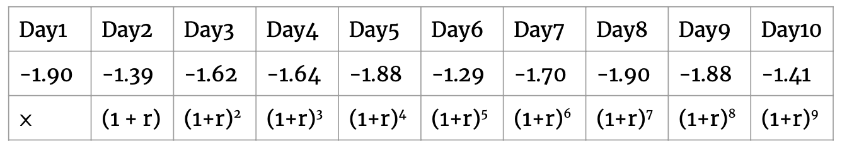
Uncertainty I: Method 1
Uncertainty I only depends on how far in the future the GFS is predicting for.
Method 1: discount factor
Notes:
The next set of models incorporate the idea of uncertainty, which means we should trust the weather forecast data to only some extent. Our partner has emphasized many times that they’d rather trigger earlier than later, because waiting means bearing more risks.
The first type of uncertainty only depends on how far in the future the GFS is predicting for, namely the time lag.
To incorporate this, we can multiply the rewards for each day by a discount factor to get the present value, just like in economics. And then perform the same optimization technique we used in the baseline model.
The single discount factor is considered as a hyperparameter that needs to be tuned.

Slide 12
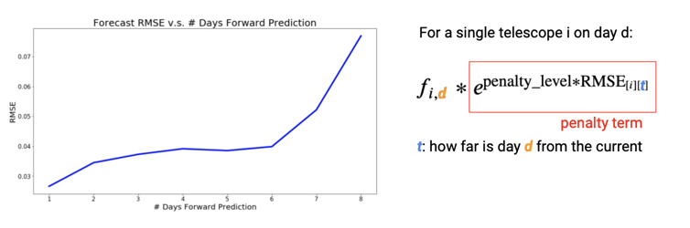
Uncertainty I: Method 2
Uncertainty I only depends on how far in the future the GFS is predicting for.
Method 2: forecast penalty
Notes:
We feel a single discount factor is not enough to explain the uncertainty in the future, so we came up with the second method. In this method, we want to find a pattern in how accurate the GFS model is, based on the time lag. Therefore, we used historical data to calculate the average error the prediction can have based on how many days into the future.
We plot the results on the left, in which the x axis is the number of days into the future and the y axis is a measurement of the error. We see the GFS model is less accurate once it passed the six-day mark.
Just like the discount factor in the previous model, we multiply a penalty term to the small f, while the penalty term depends on the time lag and a hyper-parameter called “penalty level”.

Slide 13
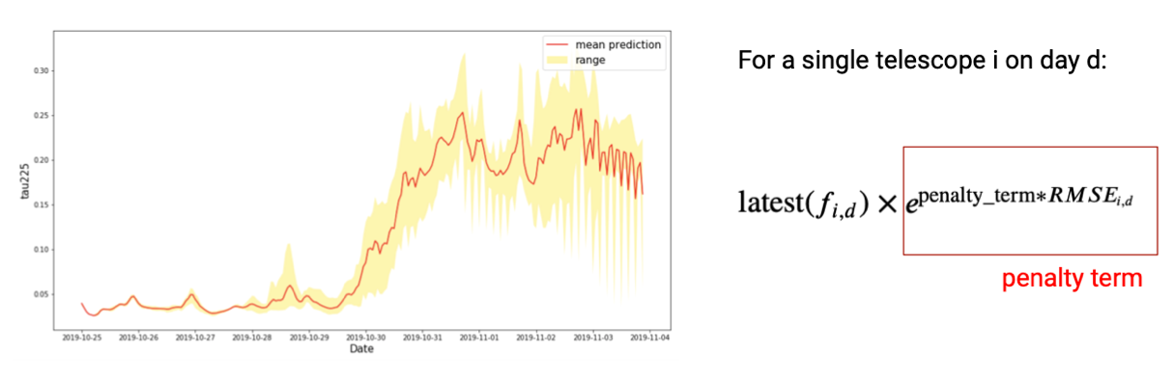
Uncertainty II: Method 3
Uncertainty II only depends on the date for which the forecast is being made.
Method 3: prediction difficulty of specific time
Notes:
The previous two models assume that the uncertainty comes from the time lag. The next two models assume that the uncertainty relates to the specific date the forecast is made for.
Remember that the GFS makes prediction every 6 hours for the next 16 days? Because of this, for each time point, we got multiple forecast information. The yellow region in the graph is bounded by the minimum and maximum forecast data of Tao-225.
For this method, we want to find the latest prediction made for a time, and calculate the RMSE of the other forecasts based on the latest prediction. We then use a similar formula as before to get the reward value, but this time the reward and penalty are both tailored to the time points.

Slide 14
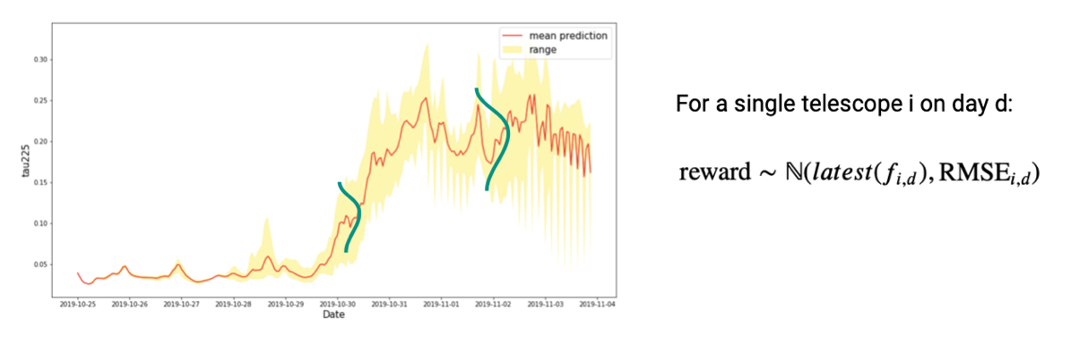
Uncertainty II: Method 4
Uncertainty II only depends on the date for which the forecast is being made.
Method 4: sampling from normal distribution
Notes:
Lastly, we still assume that the uncertainty differs for each time point, but we want to get a confidence level associated with the optimal path we suggest. We assume that the true weather would come from a normal distribution.
Following the guidance of Monte Carlo methods, we randomly sample data from the distribution for every time point enough times, and each time we find an optimal path. At the end, we summarize the frequencies of paths and conclude the best path is the one with the highest frequency. We also use its frequency to indicate our confidence level of the suggested path. We believe that our partner can make informative decisions better if they see this number.

Slide 15
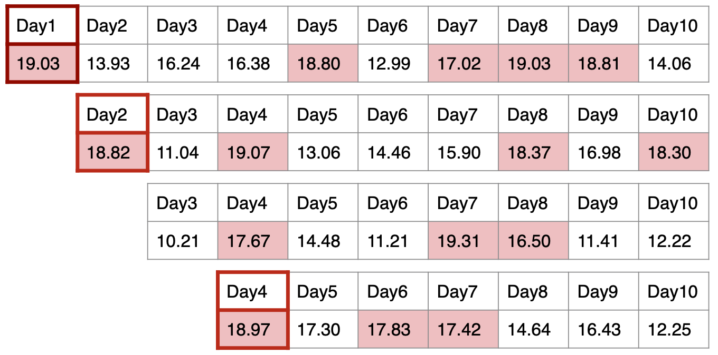
Parameters Tuning and Models Evaluation
New weather forecast
 | Oct 25 | Oct 26 | Oct 27 | Oct 28 | Oct 29 | Oct 30 | Oct 31 | Nov 1 | Nov 2 | Nov 3 | Average tau225
Model n, Penalty m |  |  |  |  |  |  |  |  |  |  | 0.13
Ground-Truth Best |  |  |  |  |  |  |  |  |  |  | 0.12
Look back
Calculate squared error
Notes:
We collected GFS data dated from 10/25 to 11/30 and ran simulations in each consecutive 10-day window. We found the best punishment level for each model as well as the best model. We chose as metric the mean squared error between the best path score and the path chosen by a model with a particular punishment level. The result is as below:
Method 3 with punish = 1 0.000015
Method 2 with punish = 0.6 0.000016
Method 1 with punish = 0.03 0.000017
Method 4 0.000028

Slide 16
Model Evaluation
Choose 5 days From Nov.09 - Nov.18, 2019
Model | Nov 09 | Nov 10 | Nov 11 | Nov 12 | Nov 13 | Nov 14 | Nov 15 | Nov 16 | Nov 17 | Nov 18 | Average Reward
Ground-Truth Best |  |  |  |  |  |  |  |  |  |  | -0.124
Random Pick | - | - | - | - | - | - | - | - | - | - | -0.176
Baseline |  |  |  |  |  |  |  |  |  |  | -0.137
Discount Factor |  |  |  |  |  |  |  |  |  |  | -0.124
Forecast Penalty |  |  |  |  |  |  |  |  |  |  | -0.124
Prediction Difficulty of Specific Time |  |  |  |  |  |  |  |  |  |  | -0.124
Sampling from Normal |  |  |  |  |  |  |  |  |  |  | -0.137
I
II
Notes:
We back-tested our models by comparing the suggested path given by different models to the ground-truth path. This is an example. We ran simulations on forecast data pulled from Nov 9 to Nov 18, so each model would give us a suggested path. We also knew the ground-truth path, so we can compare each model’s average reward with the best path’s score. In this example, only the baseline method and the sampling from distribution method did not generate the best path. But they are only one day off because they don’t penalize further days.

Slide 17
Model Evaluation
Oct 25 | Oct 26 | Oct 27 | Oct 28 | Oct 29 | Oct 30 | Oct 31 | Nov 1 | Nov 2 | Nov 3 | ... |  |  | Nov 29 | Nov 30
Average
Reward
1st 10-day window
x1
y1
2nd 10-day window
x2
y2
...
last 10-day window
x26
y26
Metrics
MSE of average reward compared with best path
Relative score computed from average reward:
(model - random)/(best - random), which ranges from 0 to 1
Notes:
We collected GFS data dated from 10/25 to 11/30 and ran simulations in each consecutive 10-day window. There are 26 10-day windows in total. One can think of all the data we received in a 10-day window as x, and the average reward when we look back as the predicted y. We can naturally compare our predicted y with the best path and compute MSE. The second one is a relative score, if our predicted path is equal to best path, then it’s 1, if its equal to the random reward then it’s 0.

Slide 18
Results
 | MSE | Relative Score (0-1)
Method 3 (prediction difficulty of specific time) with penalty = 1 | 0.000015 | 0.957
Method 2 (forecast penalty) with penalty = 0.6 | 0.000016 | 0.955
Method 1 (discount factor) with penalty = 0.03 | 0.000017 | 0.952
Method 4 (sampling from distribution) | 0.000028 | 0.951
Baseline Method | 0.000028 | 0.951
Random Pick | 0.003107 | 0.0
Notes:
With these two metrics we are able to decide the best penalty level for each method, and also the best model. Here method 3 is the winner of all models, which makes sense because it incorporates the uncertainty of weather prediction variance of each day, and method 2 here is the second best, because it only takes in the uncertainty of weather forecast in terms of how far in the future. Sampling method here is only as good as baseline because it doesn’t have any sort of penalty. However, it’s still useful because it’s the only model that outputs the confidence level of the selected path.

Slide 19
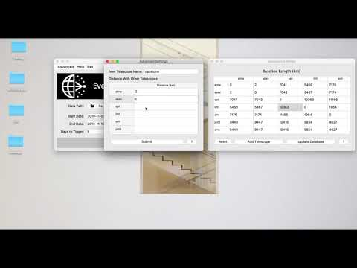
Software Demonstration
Notes:
https://www.youtube.com/watch?v=UKHaZE5Ws6c

Slide 20
Phase I
No data. Fancy model designs in mind. Had lots of questions about the problem itself.
1
Phase II
Meet the EHT Team for the first time. Slowly gathering data. Fancy models won’t work. Redesigning simple models that best solve the issue.
2
Phase III
Gathered second thoughts from the EHT. Learned to build GUI and functional software. Cannot truly tune hyperparameter due to lack of data.
3
REFLECTION
Notes:
This graph summarizes our process throughout the semester. Initially we had planned fancy machine learning models to solve the issue. After seeing the data and discussing with our partners, we had to turn back to some simple but appropriate models. Things like weird zeros in the data tried to stop us but we never gave up. Shu put her computer to pulling data every night before she went to bed. Yiming learned to build a GUI and even earned a certificate in it. We were all very proud of what we have accomplished. We also want to thank Cecilia and Pavlos for offering the help along the way. This concludes our presentation and feel free to ask questions.

Slide 21
Thank you!
Any questions?

